Slide 1
Crowd Canvass Sprint Update
Shayne Burns,
Ramzi Carter,
Wylie Frydrychowicz,
Max Rothweiler, &
Hannibal Santiago

Slide 2

Goals for Past 2 Week Sprint
Catch up on the 2 goals we missed
QR code / Survey collection page
Analysis graphs
Ability to pinpoint events from the database on the map
Create a page where volunteers can sign up for events
Create a page where volunteers can view events that they signed up for

Slide 3
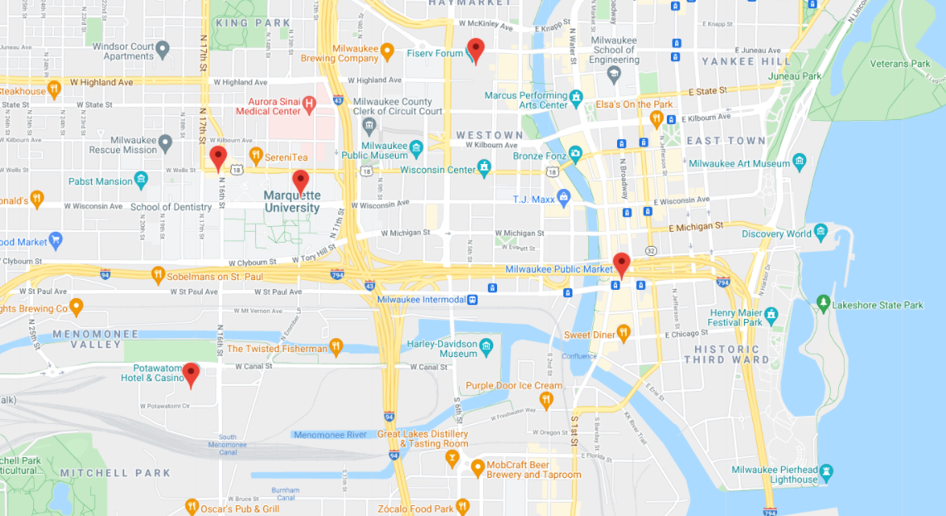
Past 2 Week Sprint Results
Ability to pinpoint events from the database on the map
UI enhancements
Google Forms tutorial page (new scope for survey analysis)

Slide 4

Goals for Final Demo
Volunteers can view events they signed up for
Survey links appears for volunteers
Volunteers can sign up for specific events
Continue improving UI
Finish Code Documentation

Slide 5

Live Demo
Web Application Link:
https://crowdcanvass.web.app/

